Slide 1
What is discrimination and how can it impact us?
A lesson for classes aged 11 - 16

Slide 2
Starter activity
Darfur in Sudan
When you hear the word ‘discrimination’ what do you think of?
When you hear the word ‘stereotype’ what do you think of?

Slide 3
Definitions
Darfur in Sudan
Discrimination - to act unfairly towards a person or group of people.
Stereotype - a description or assumption made about a group of people without evidence.
Prejudice - when you judge someone unfairly without knowing them.
Racism - when people are treated unfairly because of their skin colour or background.
Sexism - when people are treated unfairly because of their perceived gender.
Disablism - when people are treated unfairly because of their disability.
Genocide - the intentional destruction of a group of people in whole or in part.

Slide 4
What is discrimination?
Darfur in Sudan
Discrimination means to act unfairly towards a person or group of people. It occurs because of prejudice and stereotypes, often leading to exclusion or bullying.
Can you think of any examples of discrimination?
For example, racism is a type of discrimination.

Slide 5
What is a stereotype?
Darfur in Sudan
A stereotype is a description or assumption made about a group of people that is applied to all of them, regardless of whether it is factual.
Can you think of any examples of a stereotype?
For example, ‘people with brown hair love science’.

Slide 6
How does discrimination and stereotyping affect people?
Darfur in Sudan
Discrimination can be very hurtful and affect people in many negative ways.
People who experience discrimination can:
Feel scared or stressed
Have low self-esteem
Have poor mental health
Find it difficult to achieve highly

Slide 7
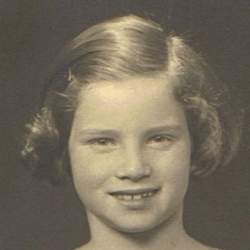
Darfur in Sudan
Impact of stereotypes and discrimination –
Ann Kirk BEM
As time went on I realised things were not as good as they should be. Mum and Dad were becoming increasingly worried. When I was about six years old, I noticed newspaper hoardings saying unpleasant things about the Jews… During this time Jews were not allowed to sit on park benches, go to swimming pools, the theatre or cinema and gradually Jews were deprived of their citizen rights.

Slide 8
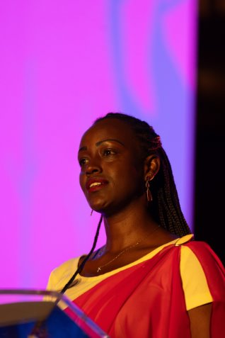
Darfur in Sudan
Impact of stereotypes and discrimination -
Antoinette Mutabazi
I faced discrimination and was often called a cockroach, a despised insect in my community. Although my parents assured me that we were all created equal, this dehumanisation had a huge impact on my self-esteem: I felt vulnerable and hated going to school.

Slide 9
Impact of stereotypes and discrimination
Darfur in Sudan

Slide 10
Discrimination and stereotypes – how can we stop them?
Darfur in Sudan
Discrimination can look like:
Being treated disrespectfully or unfairly
Bullying
Racial remarks or insulting names
Online bullying
Social media posts containing misinformation
What can we do as a class to stop discrimination and stereotypes?
As a class, create a list of things that you can do to help stop discrimination and stereotypes.

